Slide 1
Robot Raconteur Training Seminar
Day 4
John Wason, Ph.D.
Wason Technology, LLC
16 Sterling Lake Rd, Tuxedo, NY, 10987
wason@wasontech.com

Slide 2
RR Service Definition “Implements”
Robdefs can use the implements keyword to enforce that a service defines all the members of a parent Robdef and allows you to extend that definition with additional functionality
This is ideal for maintaining forwards compatibility with standard robdefs as they progress
This works well for devices that are basically the same as other devices but with additional functionality

Slide 3
RR Object References
RR Services create a root service object reference that is the first thing returned by the client connecting to the service
RR Services can also provide other object references defined in the robdef as follows:
objref mysubobj anotherobj{string}
These can refer a number of different objects using an index of either string or int
Can also use varobject type to refer an undefined object type. USE THIS WITH CAUTION

Slide 4
RR Memories
RR Memories represent a continuous segment of RAM memory potentially storing a variety of other RR types
RR Memories are designed to allow for the efficient sending of large sections of data into smaller sections
For instance a large image can be broken up into separate memory objects and transmitted sequentially and reassembled.

Slide 5
RR Pods
Pod is short for “Plain Old Data”, they are similar to structures but limited to be of uniform size in memory storage
All data in a pod is stored contiguously in c-style, compared to structures that store data using pointers
Pods can only contain Pods, NamedArrays, arrays of such and numerical primitives, no strings, structs, lists or maps can be used
In python pods are represented as numpy arrays with custom dtype

Slide 6
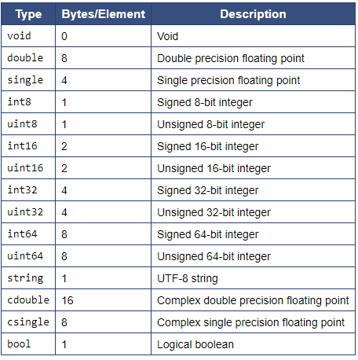
RR C++ Primitive Data Types

Slide 7
RR Timer
RR Timer is a class that calls a specified function repeatedly at a set period
RR Timers can be created using the CreateTimer function from RRNode

Slide 8
RR Pointers

Slide 9
RR Varvalue
Varvalue is used with service members to declare a wildcard parameter or packet type
In C++ it uses RobotRaconteur::RRValue for storage
This type must always be stored in boost::intrusive_ptr or can use RobotRaconteur::RRValuePtr
To be used the pointer must be downcast using boost::dynamic_pointer_cast, this will attempt to cast the pointer and will return nullptr if unsuccessful
For instance if a function returns a varvalue you can use boost::dynamic_pointer_cast to determine what type it is
Varvalue can also be declared as a container type

Slide 10
RR Subscriptions
RR Subscriptions are used to create robust connections
RR Subscriptions will create a connection to a service and attempt to maintain a connection, and reconnecting if lost
The client connection can be accessed from the service by calling GetDefaultClient or TryGetDefaultClient. It is recommended this is called before client is used to ensure that client is the most recent one
If pipes or wires are used then PipeSubscription and WireSubscription should be used to maintain connections to data
RR Subscriptions have an optional filter to make sure that the correct service is subscribed to

Slide 11
RR Subscriptions (continued)
RR Service Type Subscriptions subscribe to all services that match a certain type and match an optional filter
The connected clients from this can be accessed as a map using GetConnectedClients
It is recommended that the max connection count of the filter should be set to prevent overloading connection
The clients grabbed by GetConnectedClients are managed by the service and can be connected or disconnected
If a client needs to stay connected it can be “claimed” by the service using ClaimClient(), its lifecycle is then no longer managed by the subscription, it can then be released to give control back to the subscription using ReleaseClient()

Slide 12
RR ServiceInfo2 Subscription
ServiceInfo2 Subscriptions are used to track services as they are detected and lost
These do not create automatic client connections, can be used to display available services
The subscription is created using RR::RRNode::SubscribeServiceInfo2
The information about the available services can be retrieved using GetDetectedServiceInfo2() which will return a ServiceInfo2 structure

Slide 13
RR Logging
RR Version 0.9.3 added logging capabilities to the RR library to assist in debugging
The format of log entries can be seen here: https://robotraconteur.github.io/robotraconteur/doc/core/latest/cpp/logging.html
In C++ the log messages are sent to stderr, but they can be sent to a file using FileLogRecordHandler
The Log level can be set using SetLogLevel and the correct enum value or using the environment variable ROBOTRACONTEUR_LOG_LEVEL

Slide 14
RR Taps
Taps provide a way to record message traffic and log messages that pass through a node
Taps allow a user to inspect the operation of the system and record raw data from the system
Taps are node specific, so each node needs to activate taps to record its data
This is where Rosbag and RR Taps differ, Taps record only single nodes, Rosbag passively records the entire system’s traffic, this is because RR does not have a single master node to perform this behavior

Slide 15
RR Taps (continued)
Robot raconteur currently supports Local Taps, a local Unix socket that receives the passively sent log records and optionally message traffic.
The data is sent in Message V2 format
Local Taps are enabled via command line options, each tap must have a unique name or else the tap could fail silently or lead to undefined behavior
The local taps are created as follows:
However command line parsing must be handled in your service definition as described in the RR documentation

Slide 16
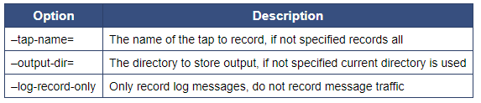
Recording and Playing Back RR Taps
To record the output of all current taps you can call the utility RobotRaconteurLocalTapRecorder as follows:
Command line options for the recording include:
An example python file to play back the files recorded from a tap exists here: https://robotraconteur.github.io/robotraconteur/doc/core/latest/cpp/taps.html

